Slide 1

First Ascent
By: Ethan (Product Owner), Celine, Scott, Minh

Slide 2
Description
An easy way for climbers to share and find newly discovered boulder problems
Users can have their own profiles to showcase the climbs that they’ve done and save climbs that they want to do in the future
Users can leave ratings, reviews, and suggestions for climbs

Slide 3
Goals
Build a website that allows users to post, rate, and search for new climbs
High Level Goals
Create a way to upload a post
Be able to search for routes
Create a profile for each user
Create a map to show different climbs in the user’s area

Slide 4
Sprint 1
3 - As a developer, I want to be comfortable with using Firebase to store data
3 - As a developer, I want to be more familiar with React.js, JavaScript, HTML, CSS, JQuery for developing our web app
5 - As a user, I want to sign-up/sign in to the app

Slide 5
Sprint 2
5 - As a user, I want to post new rock climbs/routes I find so that others can also find them.
2 - As a developer, I want to be comfortable with using Google Maps API to pin locations and show the map
2 - As a user, I want my posts to include location and directions

Slide 6
Sprint 3
3 - As a user, I want my posts to include pictures and descriptions
3 - As a user, I want to draw route lines for the climb
2 - As a user, I want to see rate and review climbs for others to see
2 - As a user, I want the difficulty of a route to be subject to a community rating system

Slide 7
Sprint 4
3 - As a user, I want to search for boulders based off difficulty or area so that I can explore new climbs
5 - As a user, I want a profile where I can show off all my climbs on a map
3 - As a user, I want to pin climbs that I am interested in

Slide 8



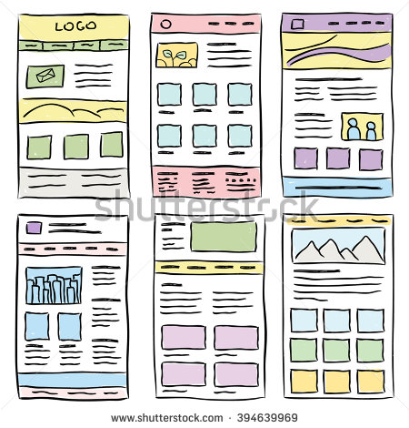
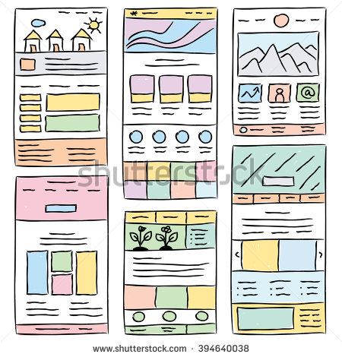
Architecture
Server
Database for storing posts and profiles
User Account
Homepage
Post

Slide 9
Technologies
React.js
Node.js
Firebase
Google Maps API
Discord
Github

Slide 10
Challenges/Risks
Learning the technology for inexperienced programmer
Dealing with schedule conflicts
Implementing database efficiently

